Slide 1
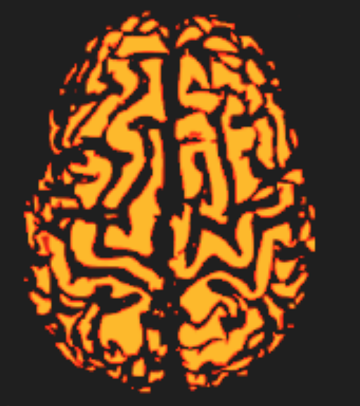
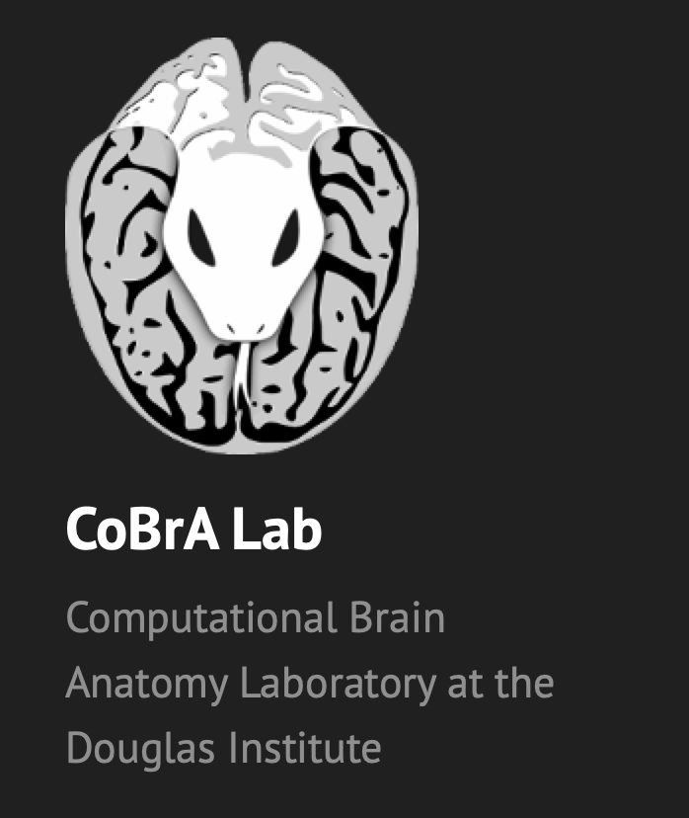
Examining the relationship between HERITABILITY and EVOLUTION
Nadia Blostein
Supervisor: Dr. Mallar Chakravarty
BRAINHACK SCHOOL 2020

Slide 2
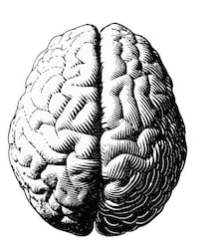
BACKGROUND | DATA | TOOLS
Additive genetic effects (A)
1
HERITABILITY
0
PLASTICITY
TOTAL BRAIN VOLUME
Environmental effects
(E)
0
1
INTUITION
Intuition: quantification of “NATURE VS NURTURE”

Slide 3
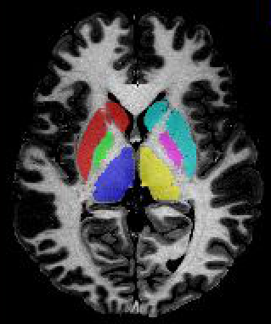
BACKGROUND | DATA | TOOLS
Additive genetic effects (A)
1
HERITABILITY
SUBCORTICAL STRUCTURE VOLUME & SHAPE
→ vertex-wise surface area
→ vertex-wise displacement
Environmental effects
(E)
0

Slide 4
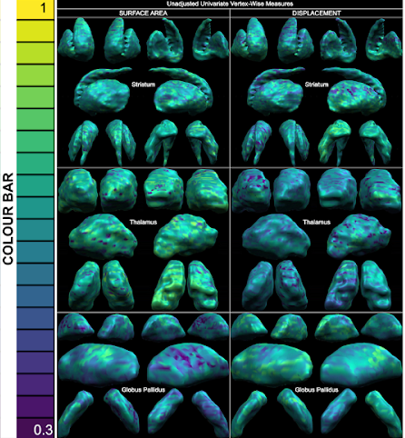
BACKGROUND | DATA | TOOLS
Additive genetic effects (A)
1
HERITABILITY
0
PLASTICITY
SUBCORTICAL
STRUCTURE SHAPE
Environmental effects
(E)
0
1
INTUITION

Slide 5
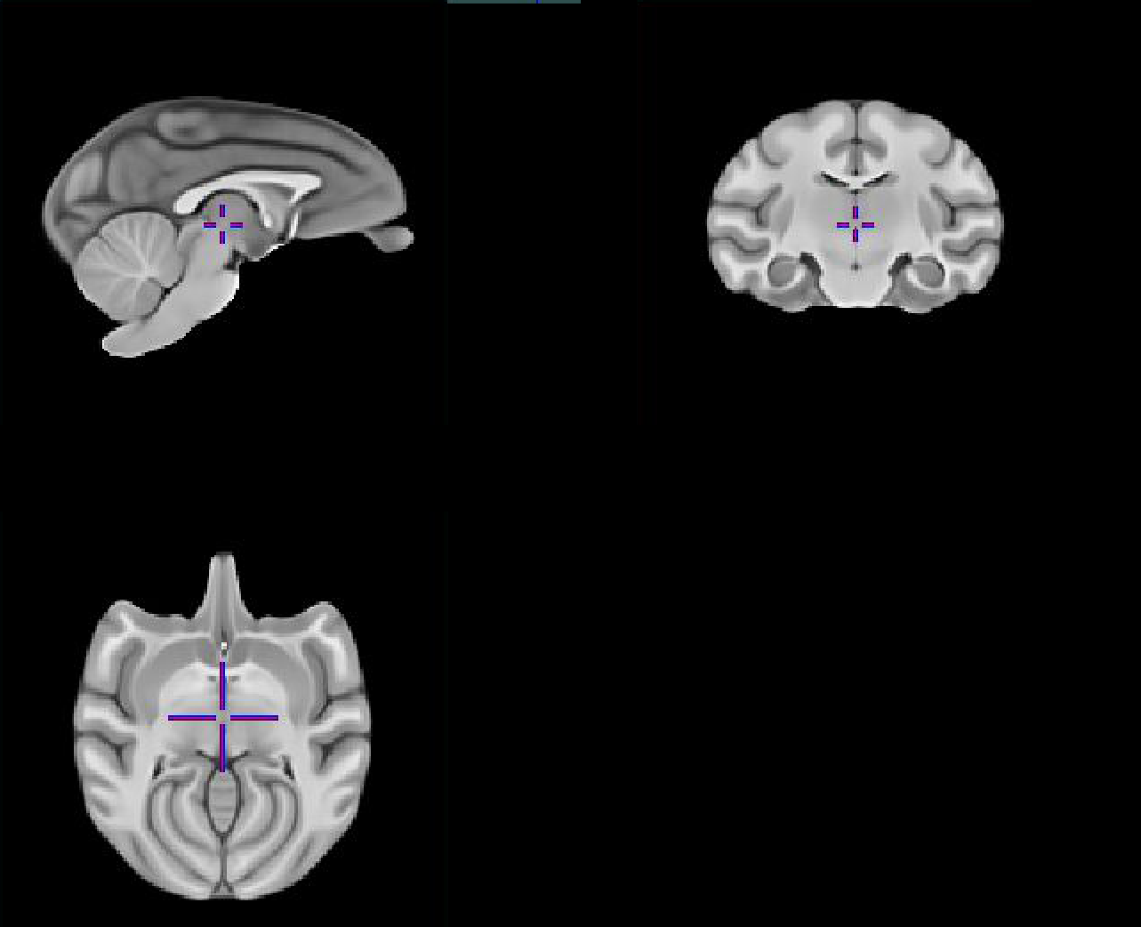
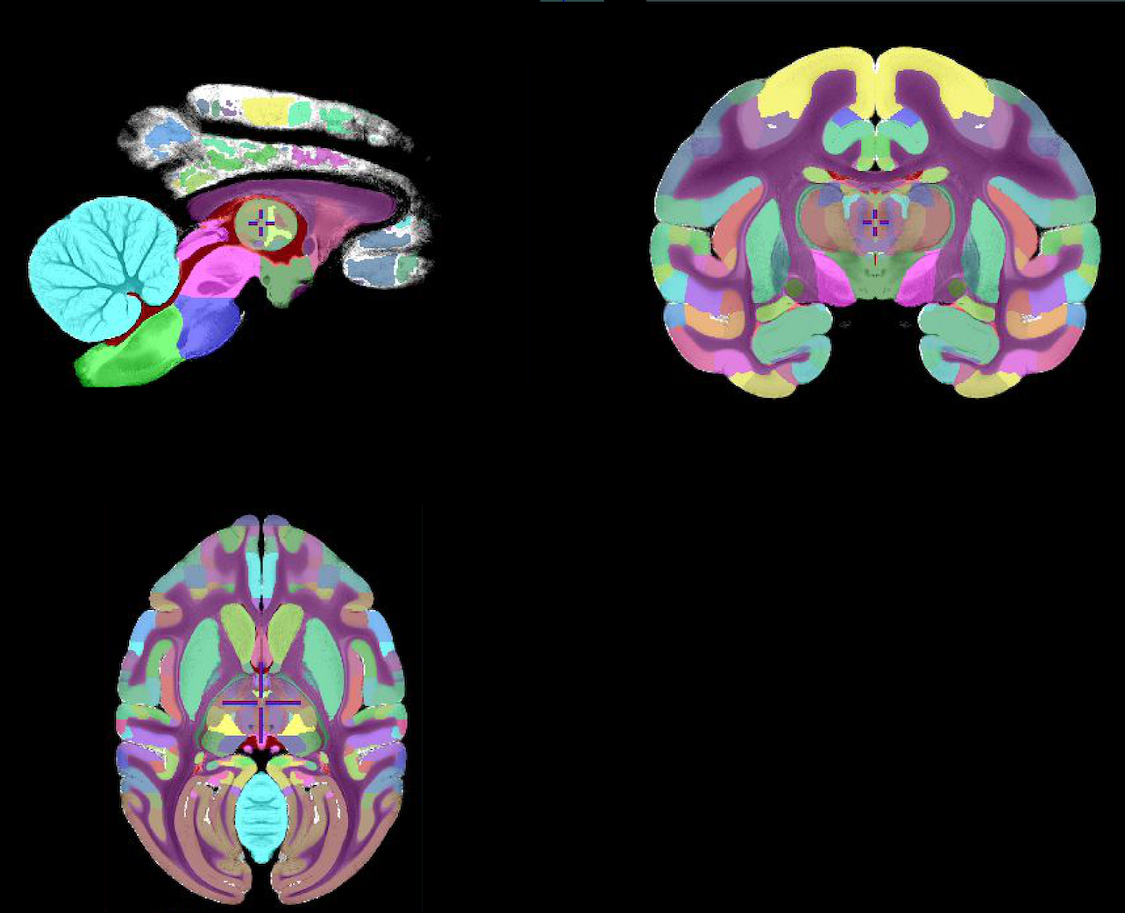
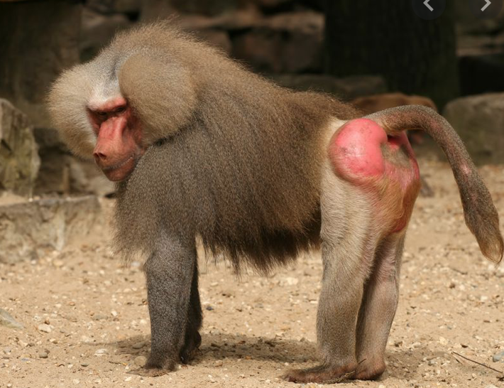
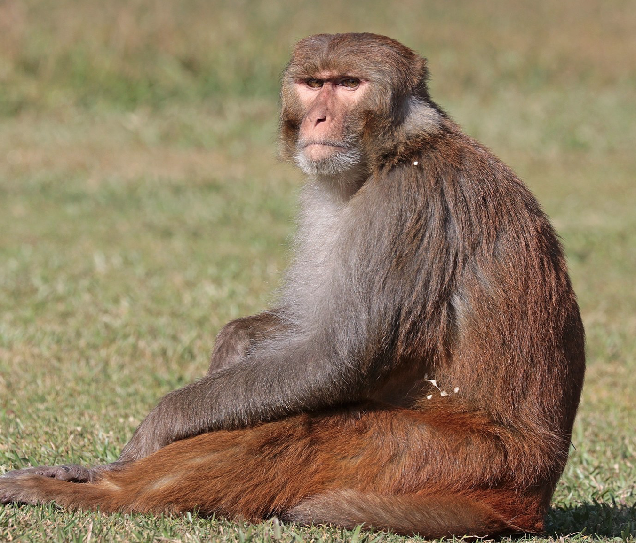
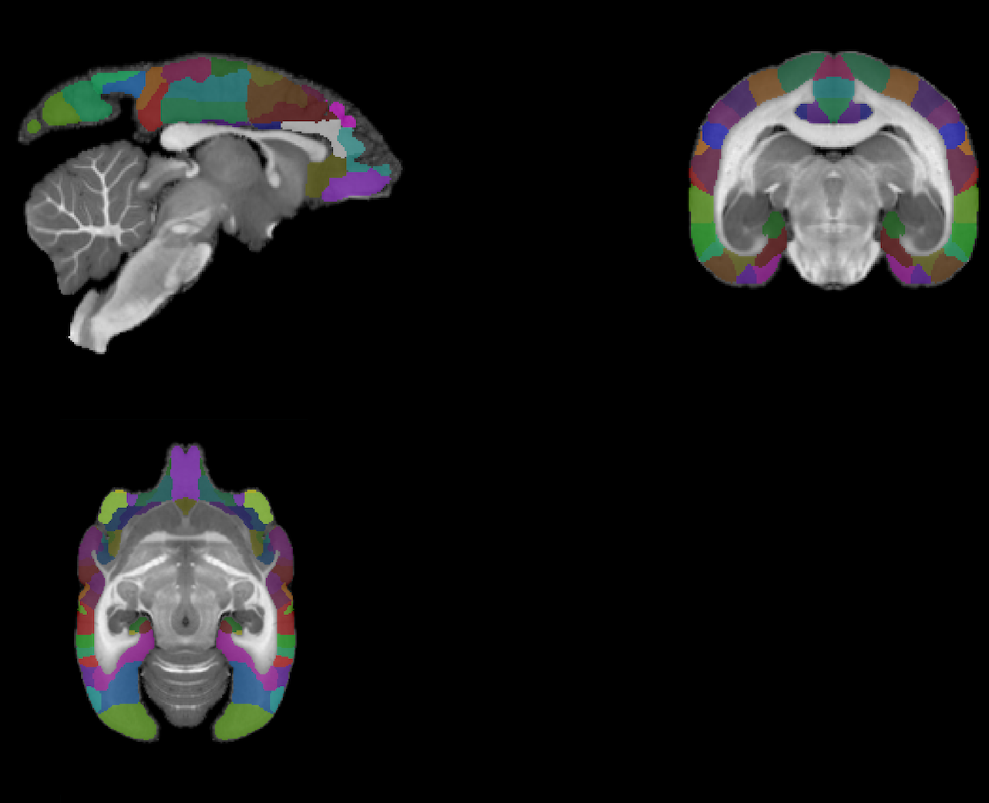
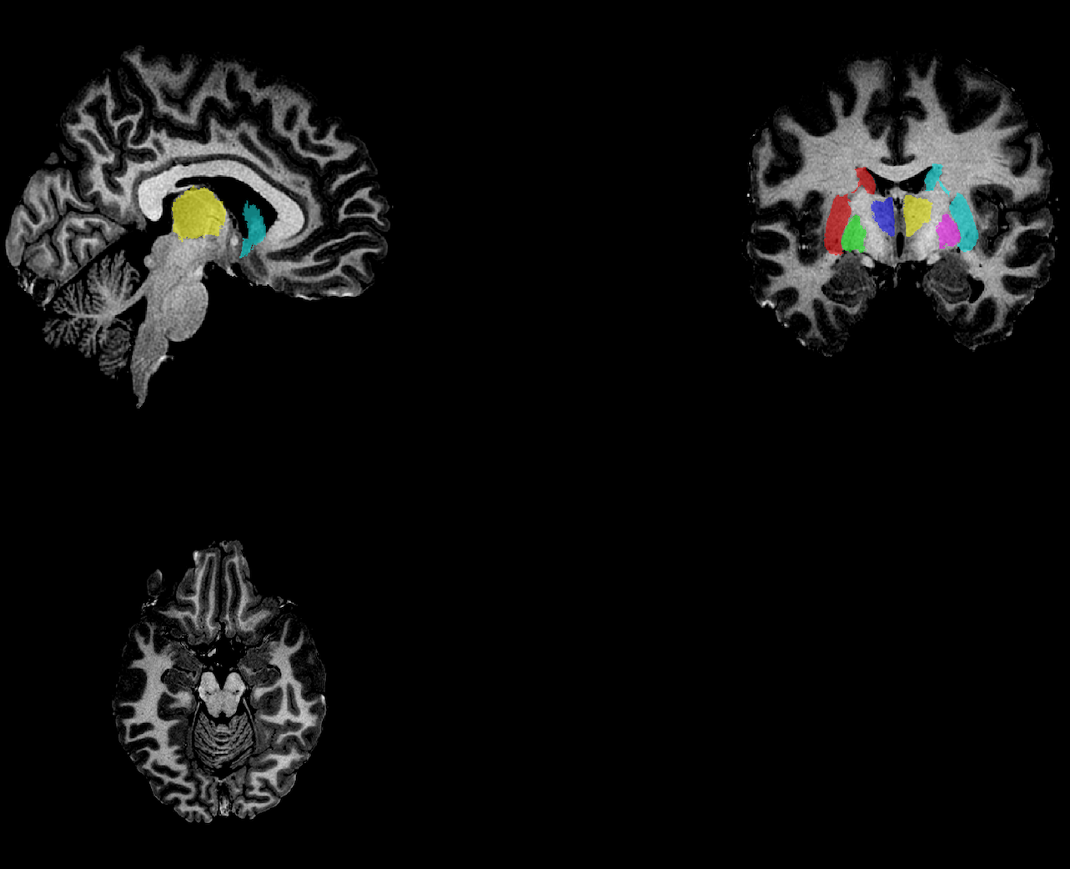
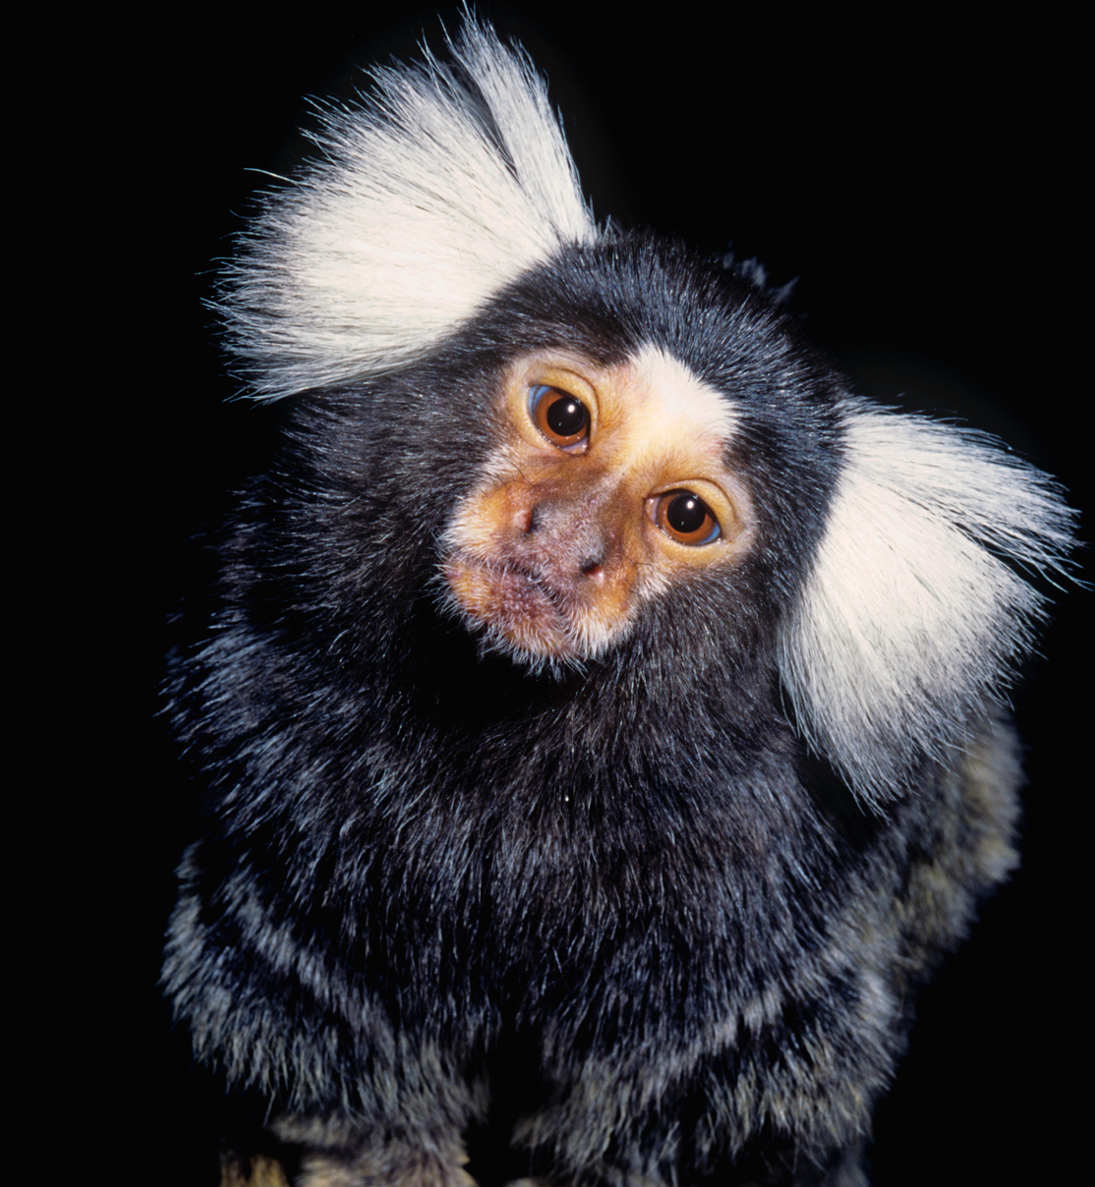

BABOON
► Template: HAIKO 89 T1w population-based average MRI
► Labels: none
RHESUS
► Template: NMT T1w MRI population-based average MRI
► Labels: surrogate D99
MARMOSET:
► Template: MBM single-subject MTR image
► Labels: beta-subcortical
HUMAN:
► Template: what would be a good template?
► Labels: CoBrA Lab subcortical labels
BABOON
RHESUS
MARMOSET
H
UMAN

Slide 6
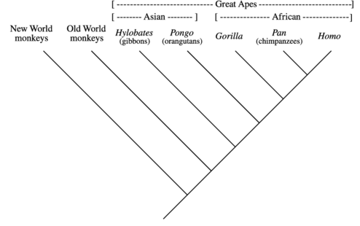
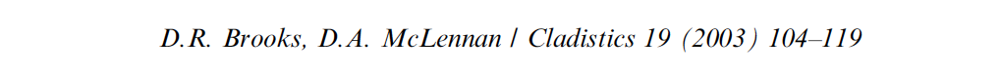
BACKGROUND | DATA | TOOLS
❓
✅
✅
✅
✅
MARMOSET
RHESUS MACAQUE
VERVET

Slide 7
BACKGROUND | DATA | TOOLS
► Advanced Normalization Tools (ANTS) to register brains to each other
→ using subcortical labels as brain masks
► Spatial permutation test (Alexander-Bloch et al. 2018)

Slide 8

Special thanks to
Sejal Patel
Raihaan Patel
Gabriel A. Devenyi
Stephanie Tullo
Eric Plitman
Saashi Bedford
Mallar Chakravarty

